Slide 1

Visual Studio 2010 and .NET Framework 4 Training Workshop

Slide 2
Presentation Outline (hidden slide):
Technical Level: 300
Intended Audience: Developers & Architects
Objectives (what do you want the audience to take away):
Understand the enhancements being made to both the server and client APIs
Presentation Outline:
Server: Row Count
Server: Server-Side Paging
Server: Friendly Feeds
Server: BLOB Streams
Client: Row Count
Client: WPF/SL data binding

Slide 3
Presentation Outline (hidden slide):
Notes:
A strong understanding of v1 is required and a good grasp of the Atom Publishing Protocol is recommended.

Slide 4

What’s New In ADO.NET Data Services 1.5
Name
Title
Organization
Email
Notes:
ESTIMATED TIME:
60 minutes

Slide 5
Agenda
Server Enhancements
Row count
Server-side paging
Friendly feeds
BLOB streams
Client Enhancements
Row Count
WPF/SL data binding
Notes:
Estimated Time: 1 minute
This presentation is going to cover enhancements that have been made to ADO.NET Data Services, on both the server and client APIs.

Slide 6


Row Count
/Products
No paging
Potentially lots of data
n # of products
/Products?$skip=10&$take=10
No idea of total
# of products
10 products
Notes:
Estimated Time: 2 minutes
Using ADO.NET Data Services today, you can make a request to a service for a specific entity set, such as “Products”. This provides a great level of flexibility to the consumer, but it comes with a few problems [Advance Animation]. Because there was no paging options applied to the request, the user has no idea just how much data they are about to get back. This could end up creating a network bottleneck [Advance Animation].
The consumer can optionally specify paging parameters in their request for products, which removes the potential bandwidth tax [Advance Animation]. The problem with this approach is that you have no idea how many products actually exist on the server. If you wanted to provide some paging functionality in a client application, there isn’t any way to determine how many pages there are without retrieving all products.

Slide 7
Row Count (cont.)
/Products/$count?$skip=10&$take=10
No data
Count
/Products?$skip=10&$take=10&$inlinecount=allpages
10 products +
Inline Count
Notes:
Estimated Time: 2 minutes
In ADO.NET Data Services 1,5, there is a new pseudo-selector that can be applied to a request: $count. As this example shows, it isn’t a query option (like $skip or $take) but rather a value that you specifically target, much like the $value or $links pseudo-selectors [Advance Animation].
When you target an entity-sets $count, you get back only the count of items in that set. This is nice if you already have the data and are only concerned with determining the server-side count. But if you want data as well as the count, this approach doesn’t lend itself as well to that scenario [Advance Animation].
In addition to the $count pseudo-selector, there is a new query option called $inlinecount that allows you to query for data and then optionally include the count inside the response [Advance Animation]. This option is great because now you can get the data you need, paged to the size you need, and also find out how many total items exist on the server, all in a single request. This makes it much easier to develop client applications that consume a data service.

Slide 8

Server-Side Paging
/Products
500,000
product records
500,000 products
You can’t always assume the client
will do the right thing…
Notes:
Estimated Time: 2 minutes
Going back to the scenario where a customer requests an entire entity set, without specifying paging information, there are additional issues than simply not being able to retrieve count data [Advance Animation]. What if there were half a million product records on the server? The customer is now able to pull that data down without possibly even knowing what they’re doing [Advance Animation]. This solution obviously won’t scale very well, and is just an all-around poor solution. A data service can’t assume that the client will do the right thing.

Slide 9
Server-Side Paging (cont.)
/Products
500,000
product records
20 products +
link to next page
/Products?$skiptoken=20
500,000
product records
20 products +
link to next page
Notes:
Estimated Time: 2 minutes
In 1.5, when a client requests an entity set that potentially contains a lot of data on the server, the service can enforce paging on the request and send back only the records it wants to give the client [Advance Animation]. This allows the consumer to continue making the same resource-centric requests they’re familiar with, but it allows to server to “guide” the client down the path of success for both ends. As part of the response content, when server-side paging is enforced, a URI will be included that points the client at the next page (if applicable). That way the RESTfulness of the service remains intact such that the connectivity of the resources doesn’t break in the name of paging [Advance Animation].
If the client follows the link for a subsequent page (that was provided by the server), the service will then respond with the appropriate page of data as well as next link (if applicable). ADO.NET Data Services 1.5 will only include next links. Links for previous, first, and last pages will come in a subsequent release.

Slide 10


Row Count Server-Side Paging
Notes:
Estimated Time: 10 minutes
This demo should show how to enable the row count feature on the service. Then highlight how you can make requests to the service using the new $count pseudo-selector and the new $inlinecount query options. Also show how to configure server-side paging on the service, and how it is enforced when making requests to the service. Finally, show how to follow the previous/next links provided by the service for paging scenarios.

Slide 11
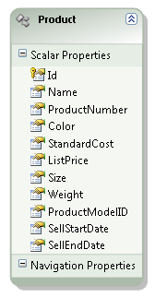
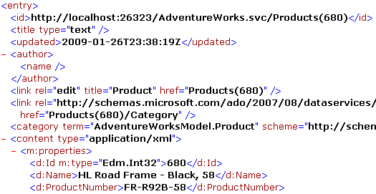

Friendly Feeds
Title?
Author?
Atom Pub (APP)
Entry Document
Notes:
Estimated Time: 2 minutes
By default, when ADO.NET Data Services exposes an instance of an entity type, it serializes the data using the Atom Publishing Protocol (Atom Pum/APP) format. Every public property on the entity type gets mapped to an element within the content of the respective entry element.
While this default behavior works just fine for many situations, there are some oddities when using APP [Advance Animation]. For instance, the APP format requires that every entry include a title and an author. ADO.NET Data Services will render these elements, but never actually fill them with content. This could confuse consumers of the service that are APP aware and would expect to be provided with a title and/or author.
In 1.5, ADO.NET Data Services introduces a feature called “friendly feeds” that allows you to map an entity property to an element within the APP entry. This can either be a pre-defined element such a title or author, or a custom element. The ability to map properties to custom elements allows you to add additional information to your data feeds, such as microformats (i.e. GeoRSS), that can be interpreted by understanding clients.

Slide 12
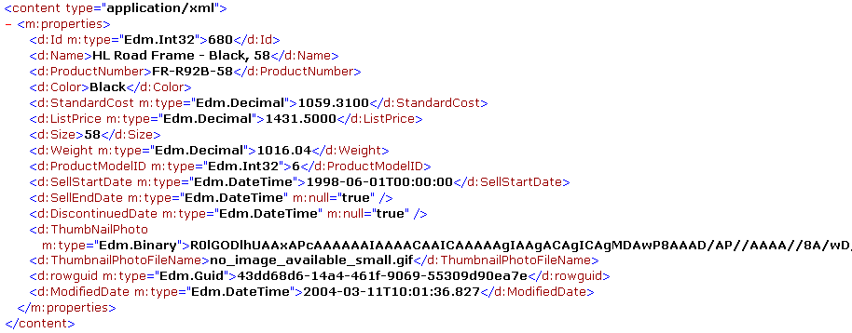
BLOB Streams
Base64 String
Notes:
Estimated Time: 1 minute
If your data service exposes an entity that contains binary data, you can end up with a less than desirable situation [Advance Animation]. Because data is ultimately serialized as string content, any binary content has to be base64 serialized before being sent to the client. This expands the size of the response and requires deserialization and base64 unencoding on the client-side. In addition, whenever a request comes in for entities with data properties, that binary data must be fully loaded into memory before it could be sent to the client. This could lead to memory issues it the service was under pressure.
If the consumer never even uses the binary data, you end up with wasted bandwidth, memory and processing time. You could remove the binary data from the entity that the services exposes, but then any clients that did need to use the binary data would be out of luck. You could remove the binary data from the entity and then create a service operation that returned the binary content, but that behavior isn’t exactly ideal and doesn’t follow the AtomPub semantics.

Slide 13

BLOB Streams (cont.)
/Products(1)/Photo
Photo Metadata
/Products(1)/Photo/$value
Photo Image
Notes:
Estimated Time: 2 minutes
In 1.5 of ADO.NET Data Services you are able to separate an entity with binary data into two pieces: a media resource and a media link entry. The media resource represents the actual binary data, as well as its content type. The media link entry represents the metadata and additional information that goes along with the binary data. This makes it possible to query the two individually.
For instance, we could query for the photo of the product whose ID is 1 [Advance Animation], which would return to us the metadata of the photo (media link entry) without the actual image binary content. If we wanted to retrieve the media resource for the photo (the binary content) [Advance Animation] we could simply append “$value” to the request [Advance Animation]. At this point it is up to the service to determine where to actually retrieve this media resource. It could come from a database, file system, the cloud, or anywhere else. Once the resource is retrieved [Advance Animation], the service returns the binary image back to the client.

Slide 14
Friendly Feeds BLOB Streams
Notes:
Estimated Time: 15 minutes
This demo should show how to leverage friendly feeds by mapping some entity properties to elements within the APP feed. It should also show an example of how create a blob stream and illustrate how it separates the media link entry from the media resource. This includes creating a custom IDataServiceStreamProvider.

Slide 15
Client Enhancements
Data Service Context
Row Count
BLOB
Server-Side Paging
Friendly Feeds
WPF Data Binding
Notes:
Estimated Time: 1 minute
Now that we’ve seen all the enhancements made to the server-side portions of ADO.NET Data Services, what enhancements have been made to the client API? Fortunately, every server-side feature that we just discussed has corresponding support on the client as well, which makes the end-to-end experience of consuming a 1.5 data service very easy and rich.
There is also one enhancement that is exclusive to the client API, WPF data binding support.

Slide 16


WPF Data Binding
Data Service
Context
4. Notify context
of the change
1. Retrieve data
Data Service
Entity
3. Modify data
within control
WPF
Framework
Element
2. Bind data to control
Notes:
Estimated Time: 2 minutes
Using the ADO.NET Data Services client API, you can create an instance of a DataServiceContext to retrieve an entity instance. Once you have the desired instance [Advance Animation], you can bind it to any FrameworkElement (or subtype) instance in a WPF application. If the bound FrameworkElement accommodates edits [Advance Animation], then you can modify the entity data via UI.
This process works just fine in v1, but the problem is that once you want to save the changes made back to the Data Service you have to explicitly notify the DataServiceContext. It would be a lot nicer if the entity instance include the necessary change tracking behavior such that when you modified its contents via its bound FrameworkElement, it would automatically notify its parent DataServiceContext of its modification [Advance Animation].
In 1.5, the client-side proxy classes for your Data Service entities include the proper INotifyPropertyChanged implementation that provides you with rich change tracking. In addition, because WPF data controls are aware of bound objects that implement INotifyPropertyChanged, they will automatically update themselves upon modifications to their bound entity instances. This makes the overall experience of developing a WPF application, that leverages ADO.NET Data Services, much simpler.

Slide 17
WPF Data Binding (cont.)
Data Service
Context
4. Notify context
of the change
1. Retrieve data
Data Service
Entity List
3. Modify data
within control
WPF Items
Control
2. Bind data to control
Notes:
Estimated Time: 1 minute
In addition to just single entity instances, if you bind a list of entities to a WPF items control, any changes made to the list via UI (instance modification/deletion) will automatically notify the parent DataServiceContext.

Slide 18
Client Enhancements
Notes:
Estimated Time: 15 minutes
This demo should show how to take advantage of the following features using the client API enhancements:
Row Count
Friendly Feeds
BLOB Streams
Server-Side Paging
The demo should consume the data service that was developed in previous demos. In addition, the demo should highlight the new WPF data binding support.

Slide 19
Summary
Server Enhancements
Row count
Server-side paging
Friendly feeds
BLOBs
Client Enhancements
WPF/SL Data Binding
Notes:
Estimated Time: 1 minute
In summary, we took a look at the new enhancements coming in ADO.NET Data Services 1.5 on both the client and server ends. This included:
Row count
Server-side paging
Friendly feeds
BLOB Streams
WPF data binding

